Slide 1
International Business Economics Programme
Sándor REMSEI PhD
Programme Supervisor
Gabriella IMRE PhD
Programme Mentor

Slide 2
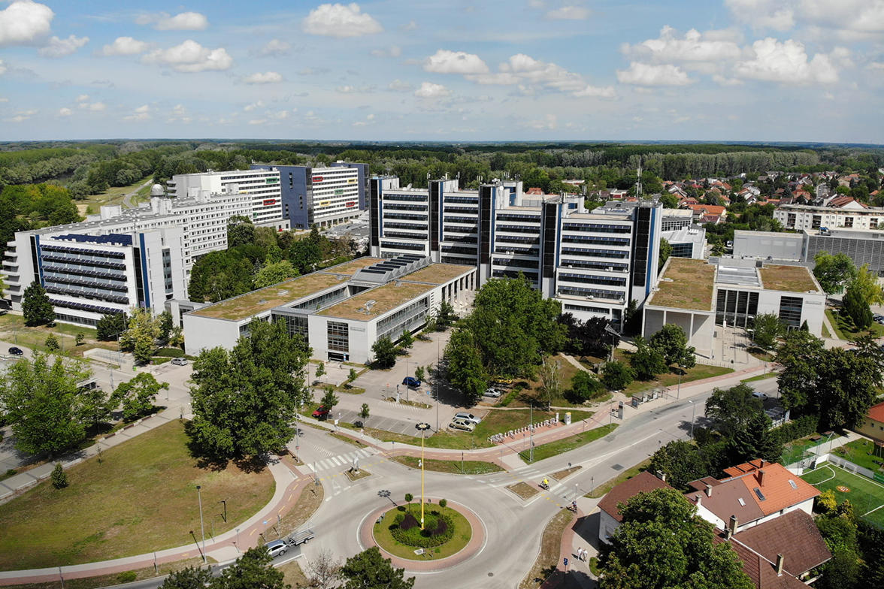
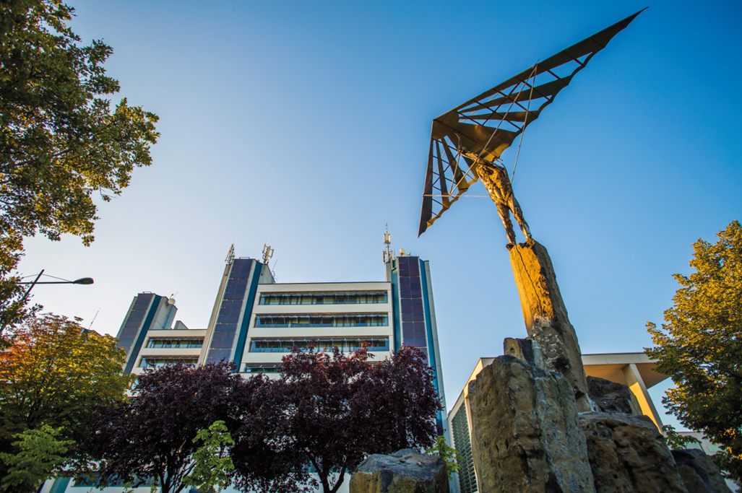


Slide 3
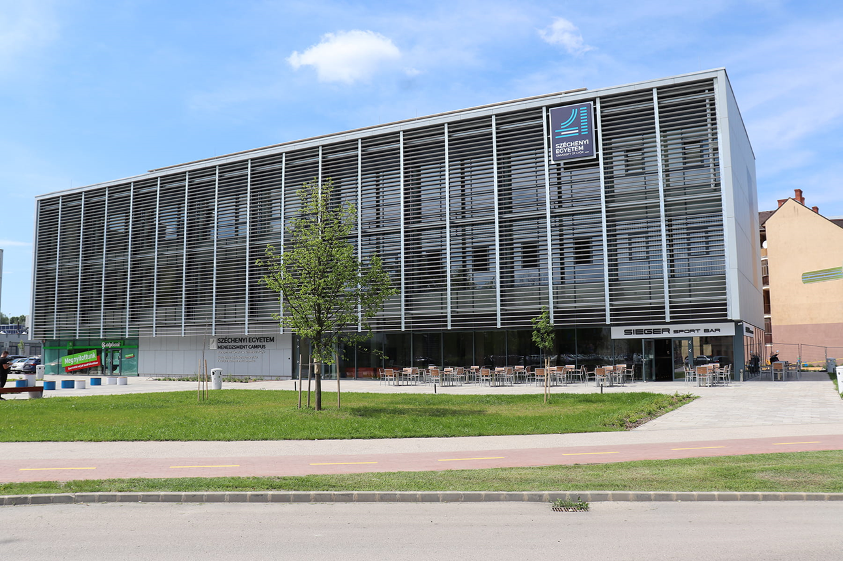
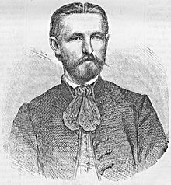
Kautz Gyula Faculty of Economics
Bachelor level (BSc) Programmes
Business Administration and Management (English, Hungarian)
Commerce and Marketing (Hungarian)
Tourism and Catering (English, Hungarian)
International Business Economics (only in English)
Gyula Kautz (1829-1909)

Slide 4
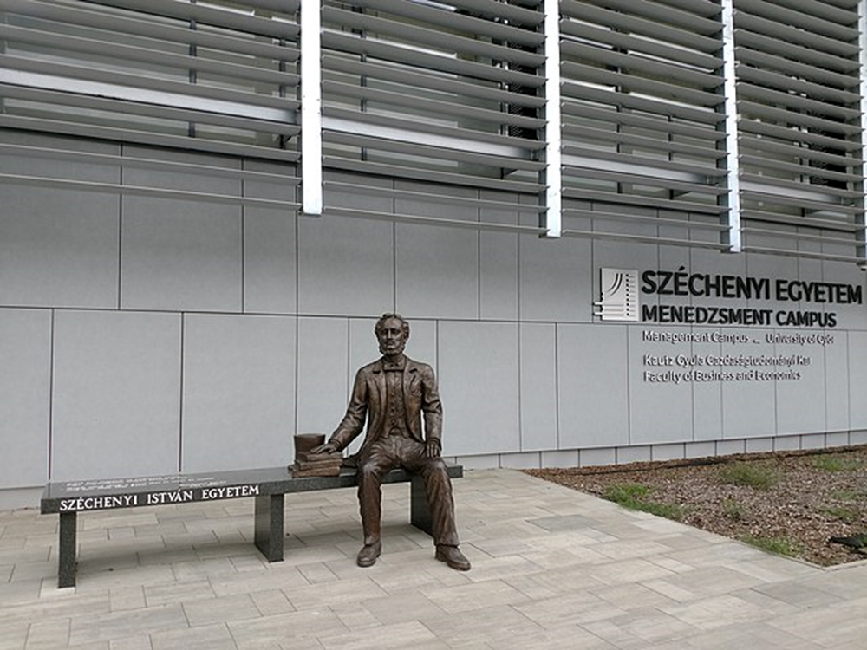
Kautz Gyula Faculty of Economics
Master level (MSc) Programmes
Supply Chain Management
(English, Hungarian)
Marketing (English, Hungarian)
International Economics and Business (only in English)
Tourism Management (English, Hungarian)
Management and Leadership (only in Hungarian)
MSc
BSc

Slide 5
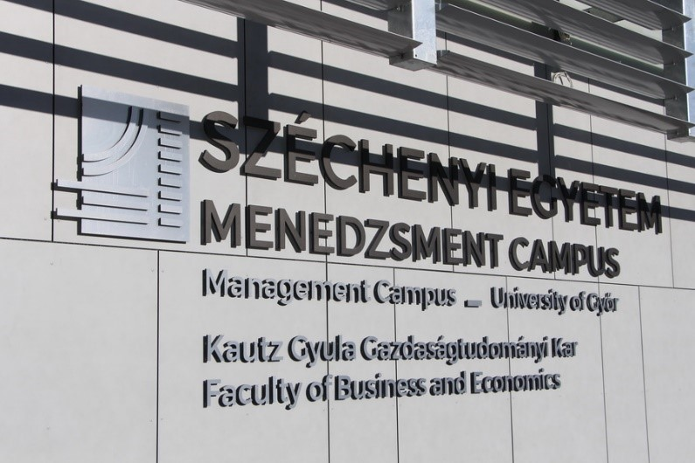
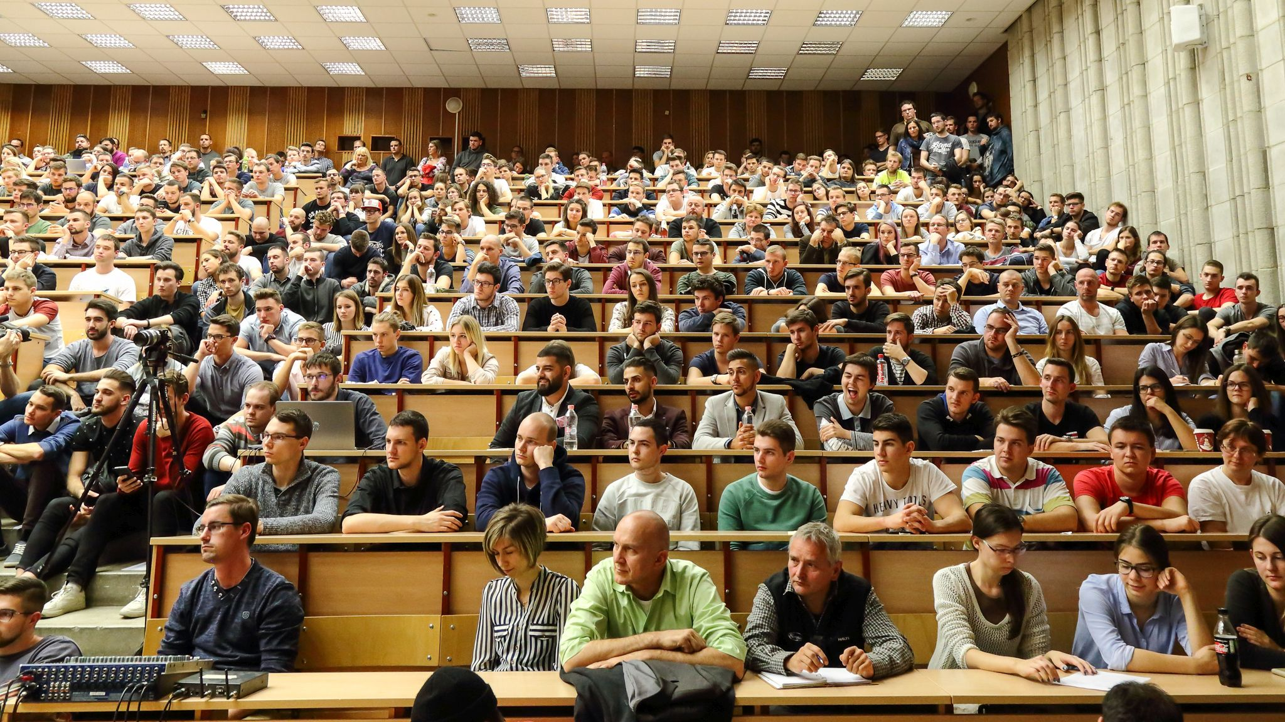
The main characteristics of the IBE programme
Course language: English
duration of the programme: 8 semesters
obtained qualification: Economist in International Business Economics
necessary credits for earning a degree: 180+60 credits

Slide 6
Main strengths of the IBE programme
it trains general businesspeople
our students learn everything a businessman needs to know + how all this can be applied in an international environment
practice-oriented

Slide 7
Our programme is designed for people who want to learn:
how to run and manage an international business
how to understand the national and international economy, economic processes and actors, the rules of international transport and international finance
how to understand the basic functions, determinants and objectives of economic policy, foreign trade processes, foreign economic policy and the functioning of the European Union

Slide 8
Structure of the studies
 | Credits
Compulsory courses (CC) | 147
Specialized electives (SE) | 23
Free electives (FE) | 10
CC+SE+FE | 180
Internship in Domestic Environment | 20
Internship in International Environment | 30
Thesis consultation | 10
Internships and Thesis Consultation | 60
Total | 240

Slide 9
Curriculum – Compulsory courses
Semester 1 | Introduction to the use of computers, Mathematics 1 for economists, Foreign economic policy, Introduction to Business Economics, Macroeconomics, Basics of Law, Sociology, Professional Foreign Language I/1., Hungarian Language and Culture 1, Student Support I
Semester 2 | Basics of project management, Finance, Business IT Tools, Mathematics 2 for economists, Statistics I, Microeconomics, Professional Foreign Language I/2., Hungarian Language and Culture 2, Student Support II
Semester 3 | Statistics II, Fundamentals of accounting , Marketing, Management,, Environmental Economics
Semester 4 | Business discourse and narratives, International Economics, Economic geography, Financial, banking and credit operations in international trade, International Organizations and Institutions, International trade in practices, EU Studies
Semester 5 | International Finances in Practice, International Logistics in Practice, Business ethics, Diplomacy, protocol and etiquette
Semester 6 | Asian Studies, Business economics, Operation of international companies
Semester 7 | Internship in Domestic Environment, Thesis Consultation
Semester 8 | Internship in International Environment
+ Physical education: obligatory in four semesters

Slide 10
Curriculum – Specialized electives
Introduction to Public International Law Law of International Economic Relations African Case Studies American Case Studies Central European Case Studies Banking operations, Basics of AI Basics of Data Analysis Basics of Operations Research EU Policies EU Public Law and Policy Financial investments Global economics International Marketing Marketing communication Data Analysis in Python for economists Programming in Python for economists Business Analysis in Excel Regional Studies Risk Management Taxation
Students need to earn 23 credits by
completing 6 courses from this group:
taking one course per semester from
semester 2 to semester 7
or by taking two courses per semester
starting from the 5th semester

Slide 11
Curriculum – Free electives
Culture Connects Current Conflicts in the World Economic and business Spanish Information management Intercultural Communication International Relations after 1945 Introduction to the innovation and research communication I Introduction to the innovation and research communication II Management Communication Managerial skills Nonprofit economics Presentation skills development Startup I Startup II Skill training II Skill training III
10 credits must be obtained
by taking 3 courses
from the group in semesters 5 and 6.
.

Slide 12
Course registration
The courses in semester 1 have been registered for first year students.
In the coming semesters it will be the students' responsibility to register for the courses.
We kindly ask all students to make sure that
they register for all compulsory courses and
complete the required number of specialised electives and free electives during each semester

Slide 13

Internships
Internship in Domestic Environment
scheduled for semester 7 in the curriculum
duration: 12 weeks
credit value: 20 credits
Internship in International Environment
scheduled for semester 8 in the curriculum
duration: 12 weeks
credit value: 30 credits

Slide 14
Internship - General information
Students are free to choose the place of their work placement.
Some expectations of the university:
the activities of the organisation must be related to the main focus of the study programme
there are positions requiring a degree / the knowledge of foreign languages
the organisation should provide the student with the opportunity to apply and practice the knowledge acquired during the study programme
the organisation should introduce the student to the international commercial, logistical and financial processes of the organisation in a real business environment

Slide 15
Internship in Domestic Environment (12 weeks)
After obtaining 50 credits from the compulsory courses.
In the same company as one 12-week period.
It can be completed
before semester 7 during the summer holiday (after the student’s last exam in the 2nd and 4th semesters - before the start of the 3th and 5th semester) or
according to the curriculum, in semester 7
The internship can no longer be completed in advance during the summer holiday following the 6th semester, as we would not be able to record its completion in the Neptun system in time.

Slide 16
Internship in international environment (12 weeks)
After obtaining 160 credits.
After the completion of the Internship in domestic environment.
In the same organisation or company as one 12-week period.
It can be completed
in semester 7 for those who completed Internship in domestic environment earlier during the summer holidays after the 2nd and 4th semester
according to the curriculum, in semester 8
Studying abroad in semester 7 or 8 is considered as an international experience. When the total number of ECTS credits obtained by the student reaches 25 credits, Internship in international environment is considered completed.

Slide 17
Compulsory courses - semester 1
 | Lessons/week | Seminars/week | Credits
Introduction to the Use of Computers | 0 | 2 | 2
Mathematics 1 for Economists | 2 | 2 | 4
Foreign Economic Policy | 2 | 0 | 4
Introcuction to Business Economics | 2 | 0 | 4
Macroeconomics | 1 | 2 | 6
Sociology | 2 | 0 | 4
Professional Foreign Language I/1. | 0 | 2 | 3
Basics of Law | 2 | 0 | 3
Hungarian Language and Culture 1 | 0 | 3 | 0
Student Support I | 0 | 1 | 2
Total | 11 | 13 | 32

Slide 18
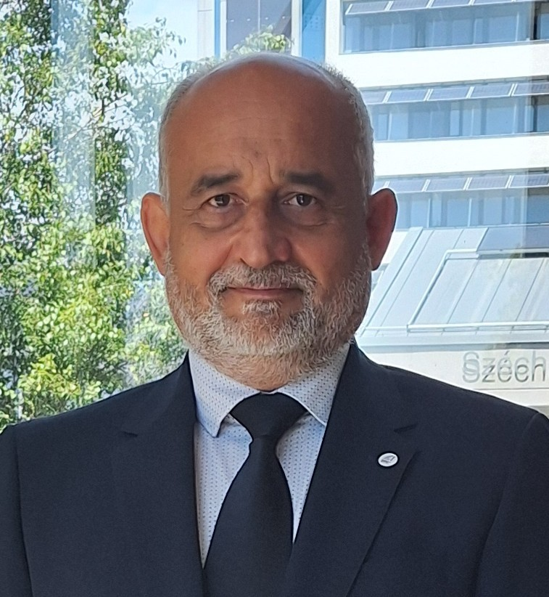

Contact information
Sándor Remsei PhD
Programme Supervisor
Head of Department, Associate Professor
Department of International and Applied Economics
Kautz Gyula Faculty of Economics
remsei.sandor@sze.hu
Gabriella Imre PhD
Programme Mentor
Assistant Professor
Department of International and Applied Economics
Kautz Gyula Faculty of Economics
imre.gabriella@sze.hu

Slide 19
Thank you for your attention!
remsei.sandor@sze.hu
imre.gabriella@sze.hu

